Slide 1
03 | Express and Databases
Stacey Mulcahy | Technical Evangelist
Rami Sayar | Technical Evangelist

Slide 2
Module Overview
Discuss Data Driven Websites
Discuss MongoDB
Discuss Redis
Show you how to connect to Azure Redis Cache
Show you how to save to MongoDB using Mongoose

Slide 3
03 | What are data-driven websites?
Stacey Mulcahy | Technical Evangelist
Rami Sayar | Technical Evangelist

Slide 4
03 | Introduction to MongoDB
Stacey Mulcahy | Technical Evangelist
Rami Sayar | Technical Evangelist

Slide 5
About NoSQL databases
Not only SQL
Different types: document based, graph databases etc.
MongoDB, Couchbase, HBase, Cassandra
Object oriented APIs
Good for large amounts of data, can be scaled

Slide 6
Using MongoDB
Need to create a mongodb
3rd party sources like MongoHQ or MongoLab
Use the MongoLab add on in Azure
Can customize and manually use via VM
Need the mongodb URI for connection

Slide 7
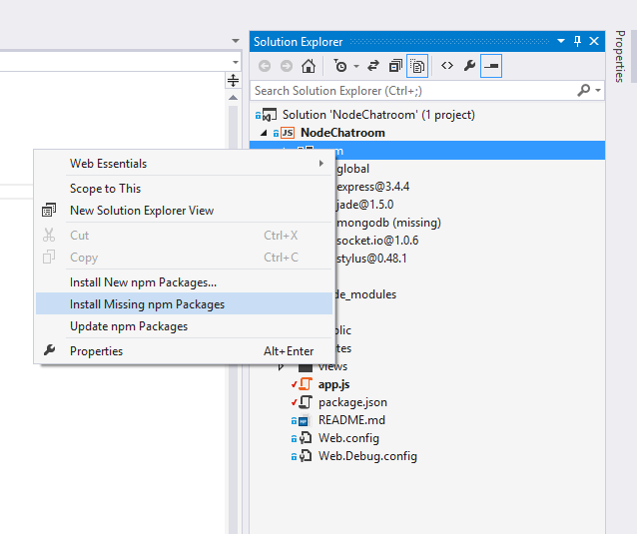
Add Support for MongoDB
Modify package.json : "mongodb": "^1.4.10",
Right click NPM in Visual Studio > right click to install dependencies

Slide 8
Running MongoDB on Your Local Machine

Slide 9
MongoDB Binaries
The following binaries are installed onto your machine
mongod – The database process
mongo – The mongodb CLI
mongoimport – A data import utility

Slide 10
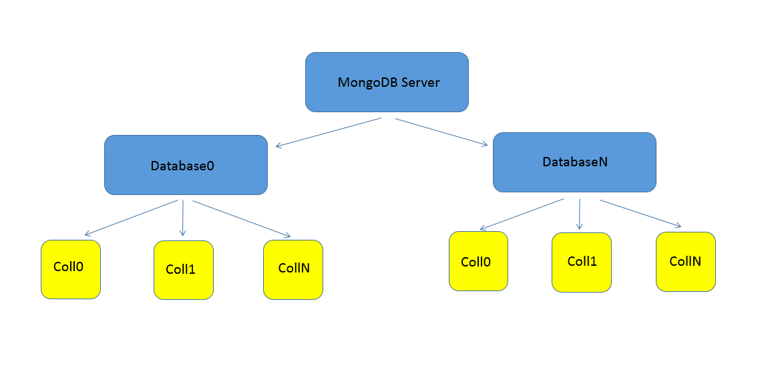
MongoDB Database Organization
Notes:
General database organization. A Server has multiple databases and databases have multiple collections. Very similar to SQL Database organization.

Slide 11
Loading Test Data
Using mongoimport
Load bulk data from CSV or JSON files
Fastest way to load data into mongodb without having to write code

Slide 12
The Interactive Shell & Queries Part I

Slide 13
The MongoDB Interactive Shell
Used to directly administer MongoDB servers
Test out new queries
Its a lot like a JavaScript interactive shell

Slide 14
Collections
Containers for a group of Documents
Databases contain many of these
Akin to a ‘Table’ in a SQL Database
Notes:
1) We will primarily work within Collections

Slide 15
Queries
Use a Query Object to Fetch Requested Data
Resembles objects already in the database
Can also be used to Update or Delete data

Slide 16
Projections
Used to filter the data you want
Similar to what SELECT does in a SQL Query
Takes similar form of Query objects

Slide 17
Module Overview
$and & $or Logical Operators
Comparison, Sorting and the $elemMatch operators

Slide 18
Getting Started
DEMO

Slide 19
Create and Update Documents
DEMO

Slide 20
Reading & Deleting Documents
DEMO

